Slide 1
Towards Real-Time Emotion Awareness in IoT
Via Multimodal Fusion
Arpan Adhikari^{1*}, Sagnik Kumar¹, Somdipta Panja¹, Anirban Santra¹, Rimi Bhattacharjee²

Slide 2
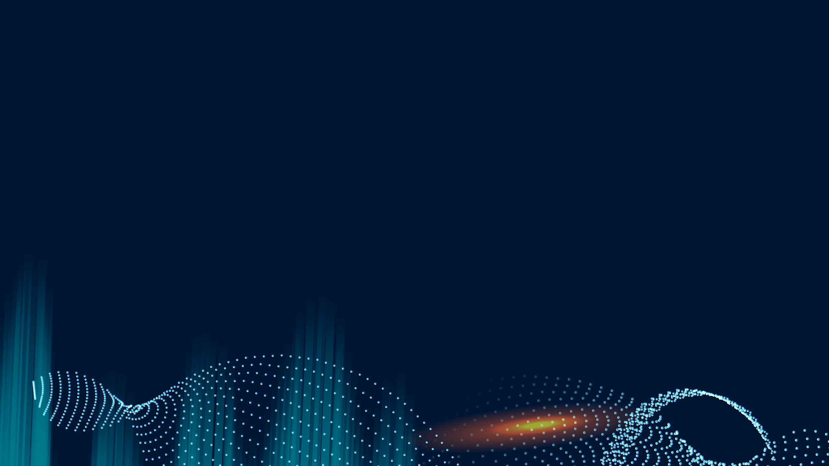
Towards Emotion-Aware IoT: Confidence-Aware Multimodal Emotion Recognition with Metaheuristic-Guided Visual Fusion for Real-Time Edge Deployment
Arpan Adhikari^{1*}, Sagnik Kumar¹, Somdipta Panja¹, Anirban Santra¹, Rimi Bhattacharjee²
¹Department of Computer Science and Electronics, Ramakrishna Mission Vidyamandira, Belur Math, Howrah
²Postgraduate and Research Department of Computer Science, St. Xavier's college (Autonomous), Kolkata
*Correspondence: arpanadhikari@vidyamandira.ac.in

Slide 3
Contents
Introduction
Related Works
Problem Domain
Solution Domain
Proposed Methodology
Results & Comparisons
Limitation & Future Scope
Conclusion

Slide 4
01
Introduction
Most emotion recognition systems plateau in accuracy and fail in real-world conditions due to reliance on facial cues alone.
Our approach fuses face, posture, and gaze to deliver stable, real-time emotional insights-enabling truly intelligent and emotionally aware smart devices.

Slide 5
01
03
Previous research prioritizes face/voice; posture and gaze are usually ignored.
Not optimized for edge deployment.
02
Some multimodal methods exist (TMNet, Emotion-LLaMA, OpenFace 3.0) but:
02 Related Works
05
Need for synchronized, lightweight, and adaptive fusion mechanisms.
04
Suffer from frame instability and lack fallback features.

Slide 6

… AND THE SAME GOES FOR TABLES
Author | Contributions | Shortcomings | Our Solution
Li et al (2023) | Kernel-based trimodal recognition | High computational overhead | Lightweight YOLOv10-CNN
Cheng et al (2024) | Emotion-LLaMA model | High costs, low interpretability | <120ms ARM optimization
Xiang et al (2024) | MultiMAE-DER fusion | Needs EEG hardware, no visual | Posture modeling + gaze inference
Muniyandi et al (2025) | EEG + Sand Cat Optimization | Requires wearable sensors | Commodity cameras only
Wu et al (2025) | Cross-lingual prompt-learning | No modality balancing | Confidence-weighted fusion
Liu (2024) | ResNet/ANN body-face fusion | No gaze-posture sync | Synchronized multi-stream
Hu et al (2025) | OpenFace 3.0 facial analysis | No posture, not edge-ready | Edge-validated posture analysis
Alam et al (2025) | TMNet EEG+speech | No visual, not low-resource | Visual-centric IoT optimization

Slide 7
03 Problem Domain
Frame Instability: Prediction jitter limits use.
High resource need: Unfit for real-time edge/IoT deployment.
Asynchrony in Fusion: Pipelines not synchronized.
Shallow Cognitive Inference: Poor mental state estimation.
Rigid Posture Models: Cannot handle body language nuance.
No fallback: Failures if one stream is missing.

Slide 8
04 Solution Domain
Propose a confidence-aware, multimodal architecture:
Camera-based gaze and cognitive state estimation.
Adaptive posture scoring using metaheuristic methods.
Confidence-weighted smoothing for prediction stability.
Tightly synchronized facial, postural, and gaze pipelines.
Achieves estimation without requiring additional hardware.
Utilizes GWO, GOA, and PSO for effective posture evaluation.
Ensures stable predictions despite varying confidence levels.

Slide 9
Input:
Face Module:
Posture Module:
Gaze Module:
Fusion Layer:
Output:
05 Proposed Methodology
01
02
03
Real-time or stored video frames processed by three modules — Face, Posture, and Gaze.
Lightweight grayscale CNN → Detects and recognizes facial emotions.
MediaPipe + GWO, GOA, PSO → Analyzes posture and its emotional impact.
04
05
06
Camera-based inference → Estimates cognitive/mental state from gaze.
Confidence-weighted temporal smoothing (EMA) → Ensures stable, reliable predictions.
Annotated video frames with overlays for:
Emotion
Posture
Gaze direction

Slide 10
Facial Module
Face Detection: The system quickly locates faces in each video frame using an efficient object detector.
Crop Extraction: Only the detected face areas are cropped and passed on for detailed analysis.
Grayscale Conversion: Each cropped face image is converted to grayscale to reduce memory and computation.
Fast CNN Emotion Classification: A lightweight neural network rapidly classifies the emotion shown in the face.
Edge Optimization: The whole process is designed for real-time use on low-power devices, maintaining strong accuracy between different expressions.
Working Steps :
Algorithm :
VideoEmotionAndPostureAnalysis(input_path)
1: InitializeIO(input_path)
2: for each frame in video:
3: posture ← EstimatePose(frame)
4: emotion ← DetectEmotion(frame)
5: UpdateCounts(emotion)
6: Annotate(frame, emotion, posture)
7: WriteFrame(Combine(frame, UpdateEmotionGraphs()))
8: CleanupAndSummarize()
9: return output_video_path

Slide 11
Posture Module
Landmark Detection: Detect key body points (shoulders, elbows, hips) from each video frame.
Angle Calculation: Calculate joint angles using the detected landmarks.
Metaheuristic Scoring: Use advanced optimization algorithms to score the posture for emotion-related patterns.
Emotion Mapping: Assign an emotion based on the posture score.
Output to IoT System: Provide postural emotion results for real-time use in smart environments.
Working Steps :
Algorithm :
AdvancedEmotionAndPostureAnalysis(video_path)
1: Initialize(video_path)
2: for each frame in video:
3: pose, angles ← DetectPoseAndAngles(frame)
4: score ← OptimizePosture(angles) if OptimStep(frame)
5: em ← PredictEmotion(DetectAndCropFace(frame))
6: final_emotion ← SmoothAndFuse(em, score)
7: Log(pose, angles, score, final_emotion)
8: AnnotateAndWrite(frame, final_emotion)
9: Finalize()
10: return output_path

Slide 12
Eye Module
Detect Facial & Iris Landmarks: Find facial and iris points in each video frame.
Extract Eye Metrics: Calculate gaze direction, pupil size, and fixation stability.
Analyze for Cognitive States: Examine these metrics for signs of alertness or anxiety.
Classify State: Assign a cognitive or emotional state based on the analysis.
Output Results: Report recognized states in real time with just a standard camera.
Working Steps :
Algorithm
VideoEyeEmotionAnalysis(video_path)
1: InitializeModelsAndIO(video_path)
2: for each frame in video:
3: for each face in DetectFaces(ConvertToGray(frame)):
4: em ← ClassifyEyeEmotion(PredictLandmarks(face), frame)
5: Update(emotion_counts, em)6: Annotate(frame, em)
7: Write(frame)
8: ReleaseResources()
9: PlotEmotionStats(emotion_counts)
10: return output_path

Slide 13

06 Result & Comparison

Slide 14
Emotion Distribution Result

Slide 15
SOMETIMES, COMPARISONS ARE GOOD
Author | Model | Accuracy (%) | F1-Score (%) | Latency (ms) | Params (M) | Deployment | Modality
Wu et al. [11] [2025] | MERC-PLTAF | 90.0 | 88.5 | 150 | 67 | No | Audio-Text
Khan et al. [5] [2025] | MemoCMT | 91.3 | 90.2 | 140 | 92 | No | Vision-Audio
Cheng et al. [3] [2024] | Conv-Attention-Emotion-LLAMA | 85.3 | 85.8 | 200 | 160 | No | Vision-Audio-Text
Hu et al. [4] [2025] | OpenFace 3.0 | 89.2 | 87.4 | 130 | 52 | Yes | Face-Gaze
Alam et al. [1] [2025] | TMNet | 84.7 | 84.0 | 170 | 45 | No | EEG-Audio
Proposed Method | – | 92.5 | 91.7 | 120 | 48 | Yes | Face-Posture-Gaze

Slide 16
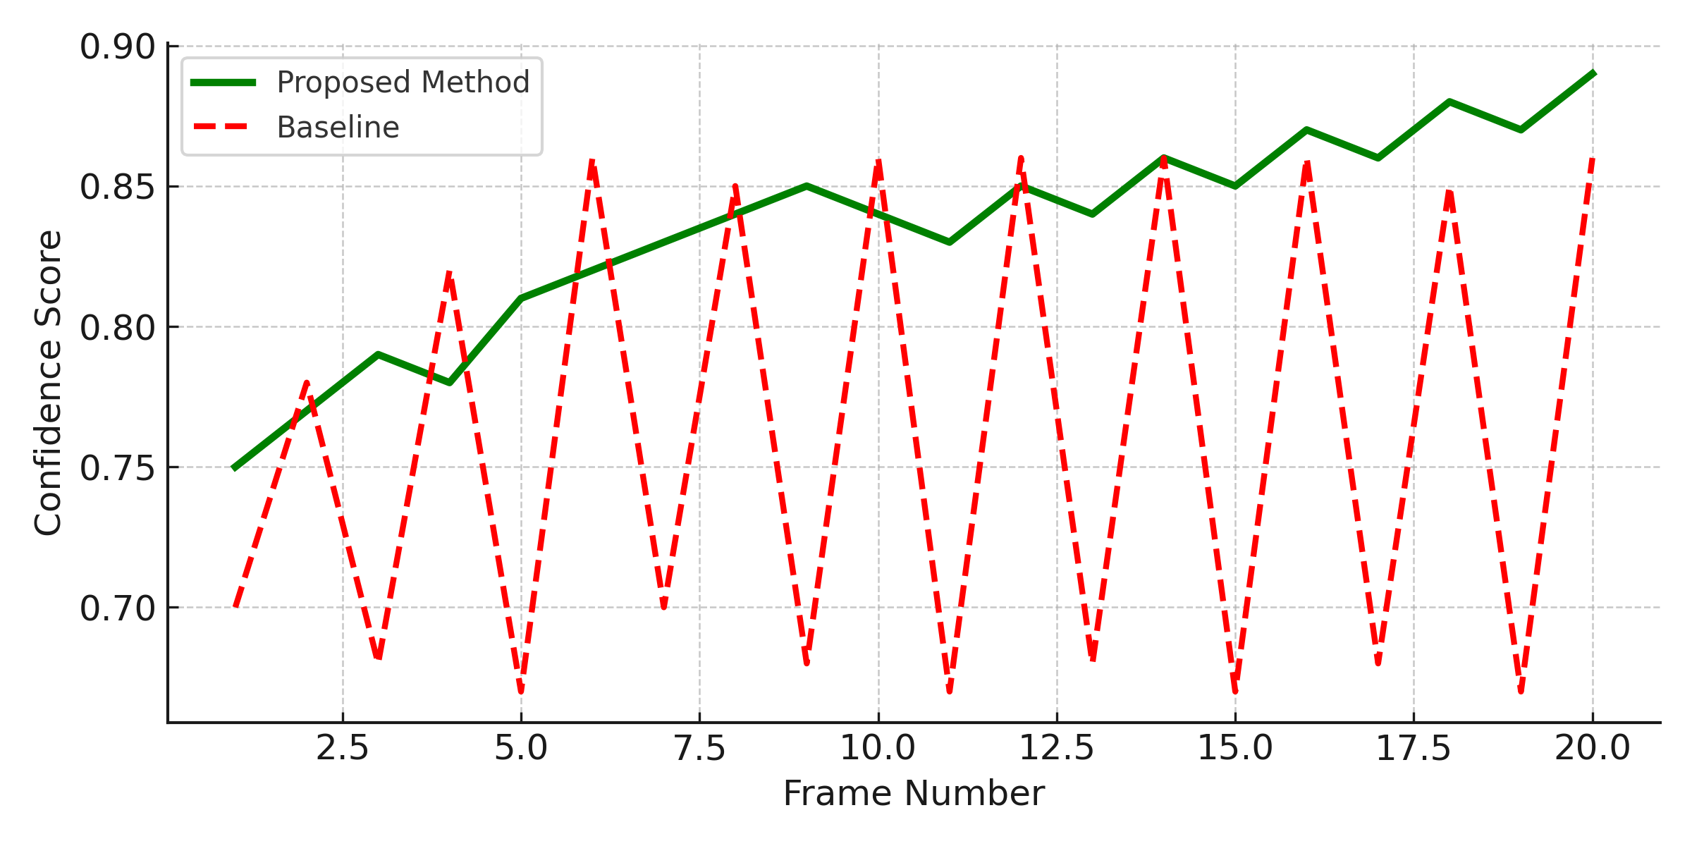
Comparison Graph

Slide 17
07 Limitation & Future Scope

Slide 18

Limitation
The current system does not incorporate audio or physiological inputs (e.g., heart rate).
Performance may need further optimization for challenging conditions like low light or severe facial occlusion.

Slide 19
Future Scope
Add audio & EEG
Handle low-light/occlusion:
Use unsupervised learning:
Real-world deployment:
Future plans to expand to speech and physiological signals.
Enhance vision under poor or partial conditions.
Reduce the need for manual data labeling.
Test in homes, cars, and clinics.

Slide 20
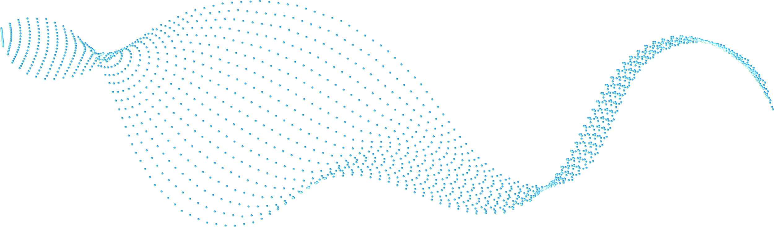



Conclusion
This work presents a confidence-aware multimodal emotion recognition system that fuses facial, postural, and gaze data. It achieves high accuracy (92.5%) and low latency (120 ms), outperforming state-of-the-art models. Temporal smoothing ensures stable predictions, and successful deployment on an ARM Cortex-A72 confirms its suitability for real-time, resource-limited IoT applications.

Slide 21
Reference
Alam et al. (TMNet): Combines EEG and speech for emotion prediction.
Cheng et al. (Emotion-LLaMA): Uses multimodal fusion with audio-visual-text.
Xiang et al. (MultiMAE-DER): Applies masked autoencoders for dynamic emotion.
Hu et al. (OpenFace 3.0): Facial behavior toolkit including gaze tracking.
Kumar & Li: Combines face and physiology with interpretability.

Slide 22
A GOOD WAY TO END THE PRESENTATION
Your patience and attention on it !

Slide 23
Thanks !
Do you have any question ?

